Slide 1
Unsupervised Machine Learning (ML) and Clustering Algorithms
Felix Gonzalez, P.E.
felix.gonzalez@gmail.com
fgonzaleumbc/DATA601.com

Slide 2
Unsupervised ML and Clustering Algorithms
Unsupervised ML and clustering algorithms find patterns within a dataset and creates groups or clusters using these patterns
Clusters can then be analyzed individually (e.g., statistics, ranking, behaviors, etc.) to extract insights
Main types of clustering algorithms:
Centroid based
Density based
Notes:
Clustering algorithms characteristics:
Centroid based algorithms require user to specify number of clusters to divide the data into. The algorithm will assign each record to a cluster which has a centroid and the resulting clusters are linearly separable.
Density based algorithms require the user to specify at a minimum two parameters, (1) minimum samples in a cluster and (2) Epsilon/EPS parameter. The EPS parameter is a distance metric of how far a data point is to its neighbors. If a data point or record does not meet both of the parameters, the data point is considered noise or an outlier.
Exercise Notebook uses clustering algorithms to group data from Disney Shows data or Unidentified Flying Objects reports.

Slide 3
Group/Clusters
How many features are we plotting?
How many groups do you see?
Which distance metric did you use to create groups and thoughts on why?
Thoughts on optimal number of clusters?
Do you see any outliers?

Slide 4
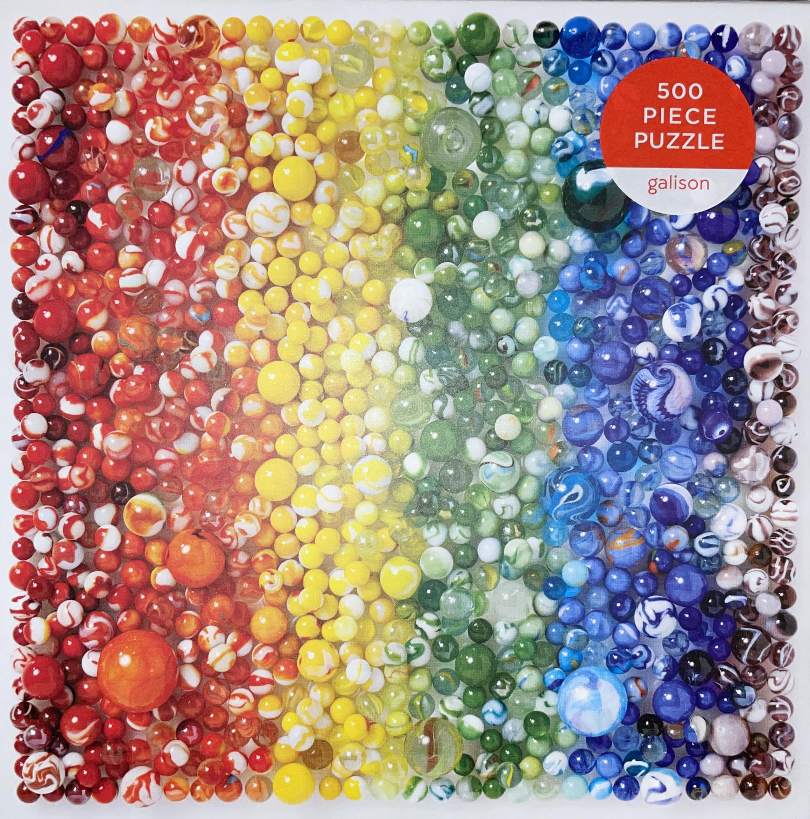
Unsupervised ML: Puzzle Example
What do we do when we start a puzzle?
What data features do we use?
Notes:
Unsupervised ML attempts to simulate that logic of grouping.

Slide 5
Sample Machine Readable Puzzle Data
Piece | Corner | Border | Border Sides | Slot Sides | Knob Sides | Primary Color
1 | Yes | Yes | 2 | 2 | 0 | Red
2 | No | No | 0 | 4 | 0 | Yellow
3 | No | Yes | 1 | 3 | 0 | Green
4 | No | Yes | 1 | 2 | 1 | Yellow
5 | No | No | 0 | 2 | 2 | Blue
6 | No | No | 0 | 1 | 3 | Red
7 | Yes | Yes | 2 | 1 | 1 | Purple
8 | No | No | 0 | 3 | 1 | Purple
9 | No | No | 0 | 2 | 2 | Blue
10 | No | Yes | 1 | 1 | 2 | Red
With Data Transformation and Derived Features
Piece | Corner | Border | Border Sides | Slot Sides | Knob Sides | Primary Color | Red | Yellow | Green | Blue | Purple | Total Sides
1 | Yes | Yes | 2 | 2 | 0 | Red | 1 |  |  |  |  | 4
2 | No | No | 0 | 4 | 0 | Yellow |  | 1 |  |  |  | 4
3 | No | Yes | 1 | 3 | 0 | Green |  |  | 1 |  |  | 4
4 | No | Yes | 1 | 2 | 1 | Yellow |  | 1 |  |  |  | 4
5 | No | No | 0 | 2 | 2 | Blue |  |  |  | 1 |  | 4
6 | No | No | 0 | 1 | 3 | Red | 1 |  |  |  |  | 4
7 | Yes | Yes | 2 | 1 | 1 | Purple |  |  |  |  | 1 | 4
8 | No | No | 0 | 3 | 1 | Purple |  |  |  |  | 1 | 4
9 | No | No | 0 | 2 | 2 | Blue |  |  |  | 1 |  | 4
10 | No | Yes | 1 | 1 | 2 | Red | 1 |  |  |  |  | 4

Slide 6
Example: Customer Data
In customer segmentation the goal is to group customers for targeted actions (e.g., promotions)
Customer data may include:
Age
Gender
Annual income
Spending habit
Family size
Profession
Work experience
The clustering algorithm creates groups based on the features. Groups statistics can then be analyzed for patterns and targeted actions.
Similar approach can be used for text data.

Slide 7
Python Clustering Example Datasets
Dataset 1: Disney Plus Movies and Shows
https://www.kaggle.com/datasets/shivamb/disney-movies-and-tv-shows
Dataset 2: Unidentified Flying Object (UFO)
https://www.kaggle.com/datasets/NUFORC/ufo-sightings?select=complete.csv
https://github.com/planetsig/ufo-reports

Slide 8
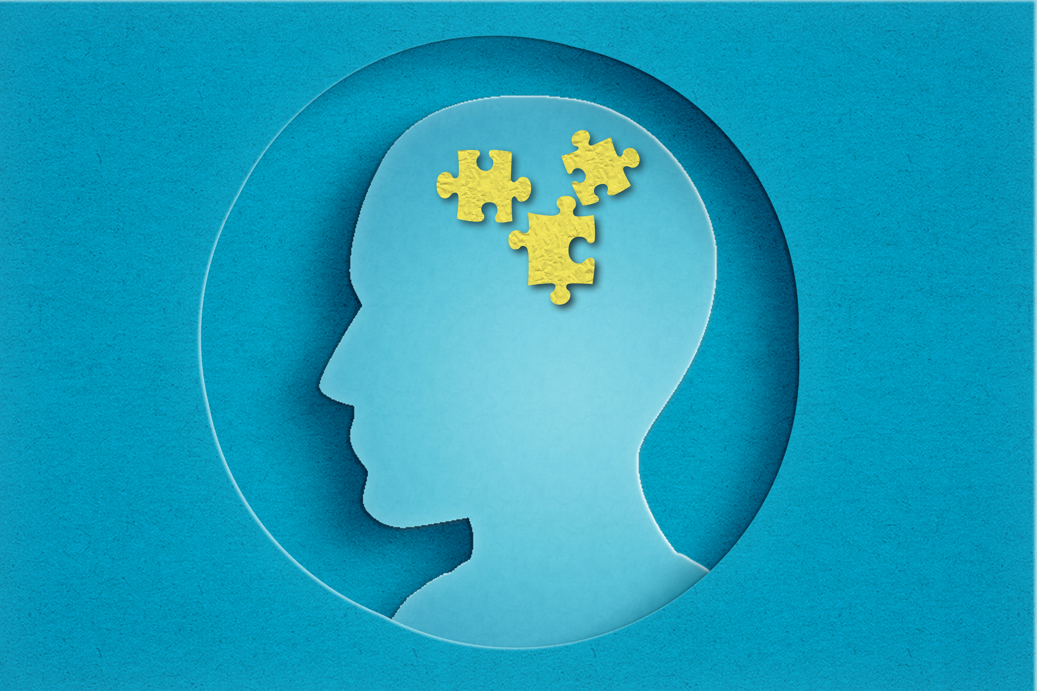
Questions?
Notes:
Marble Puzzle: What things do we do when starting a puzzle?

